Slide 1
Eyeglasses eShop Wire Frame Overview

Slide 2
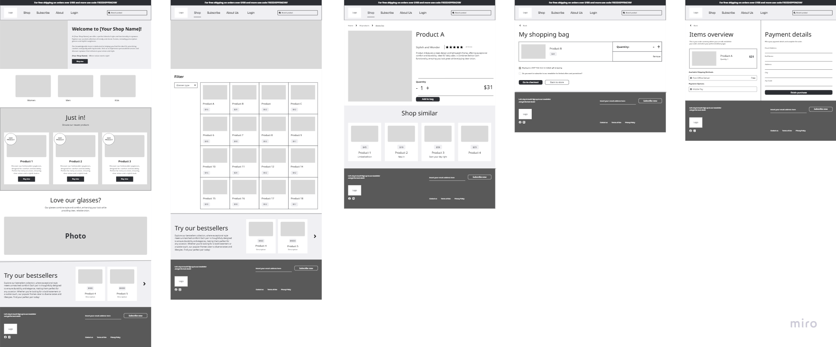
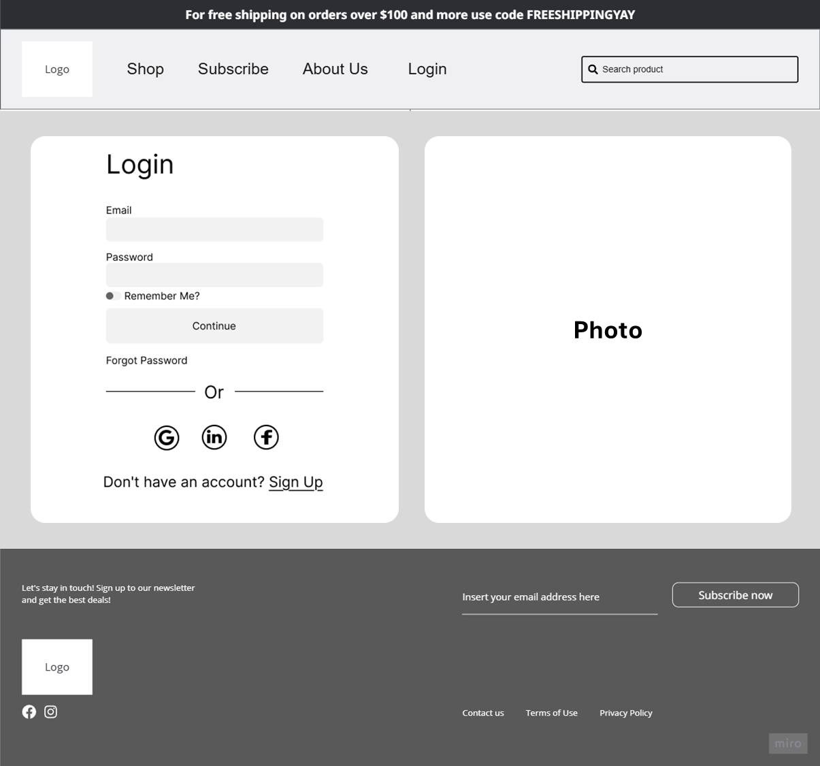
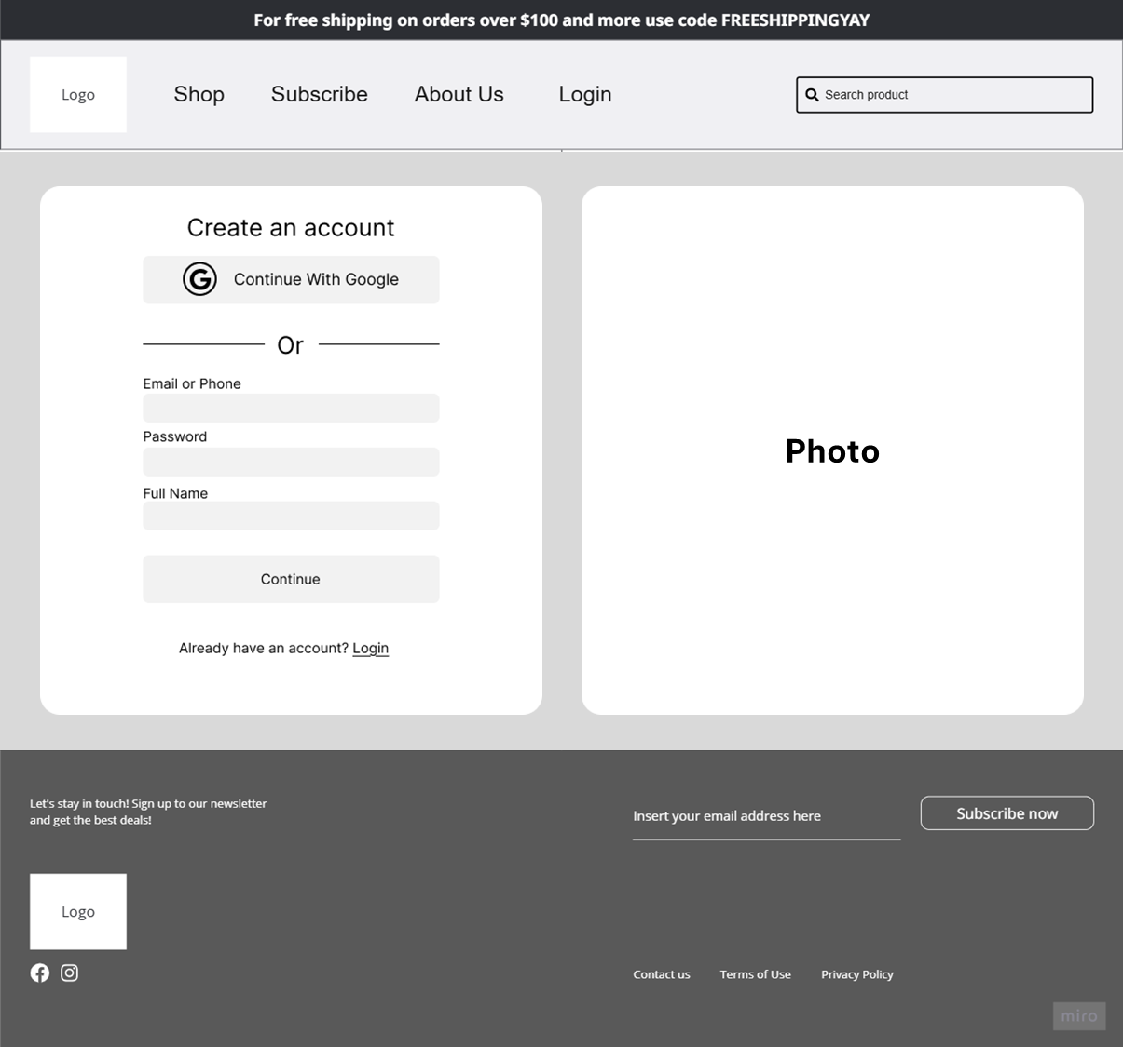
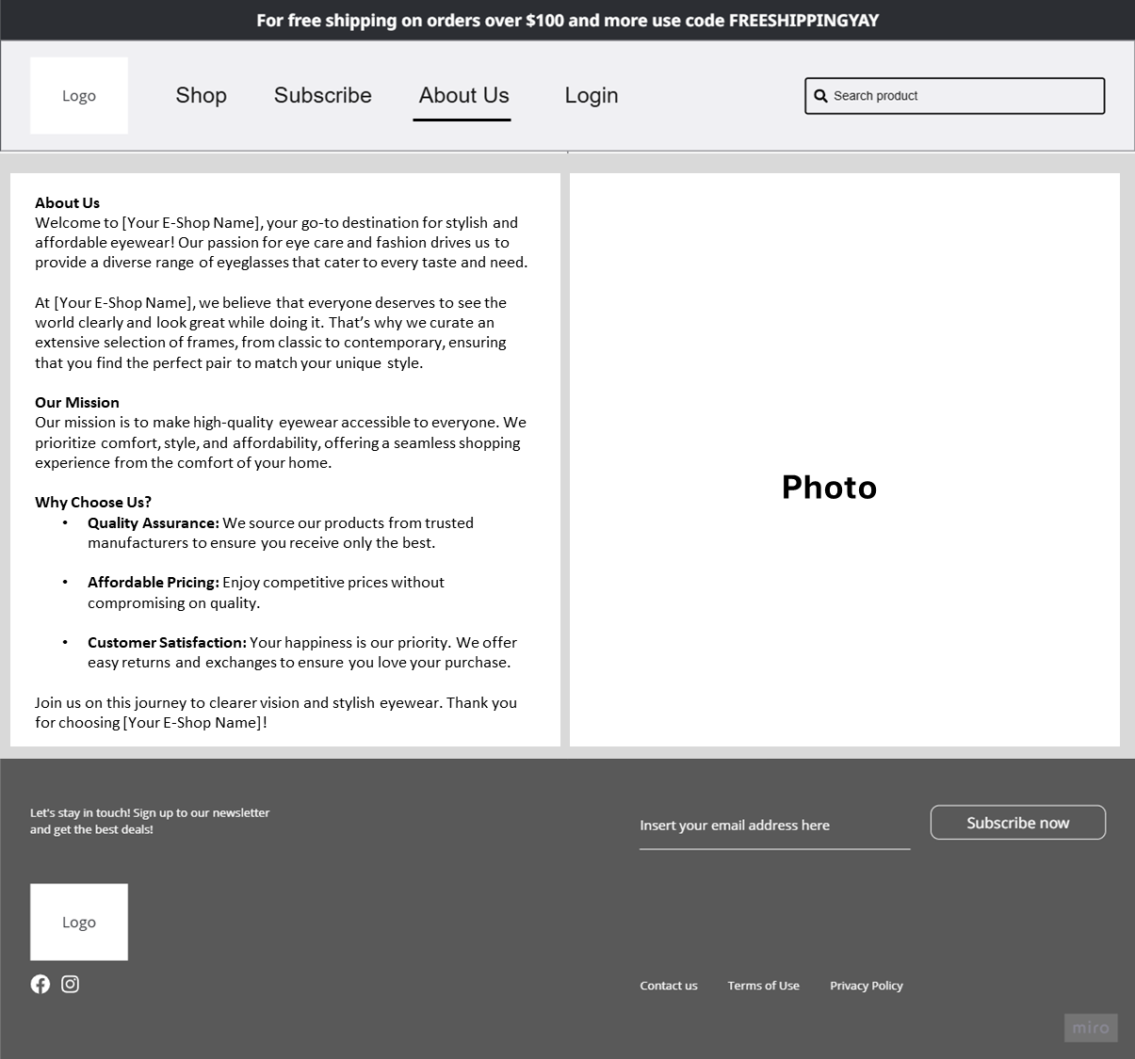
Overview
Home
Glasses Selection
Product Details
Shopping Basket
Purchase
Login
Sign Up
Abou Us

Slide 3
Eyeglasses eShop Wire Frame Details

Slide 4
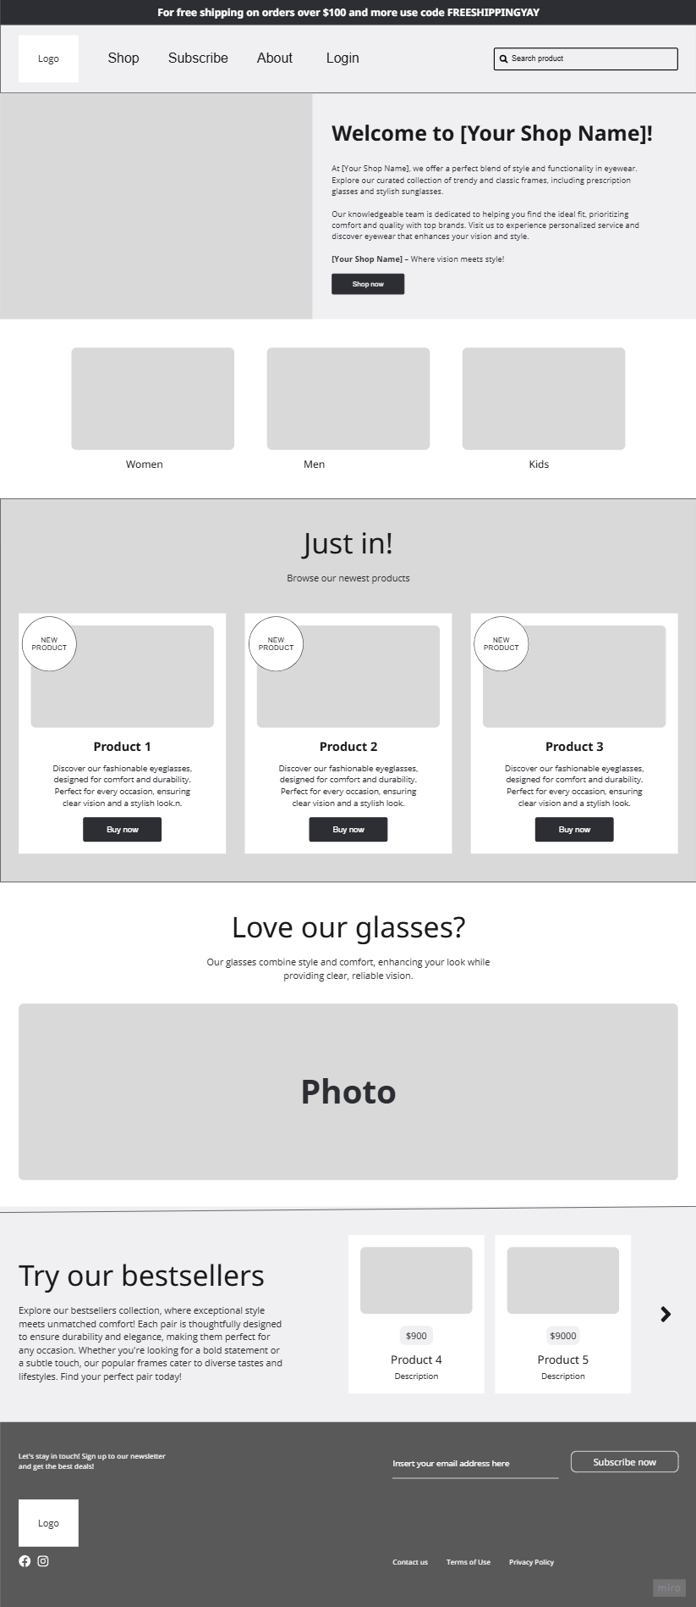
Home

Slide 5
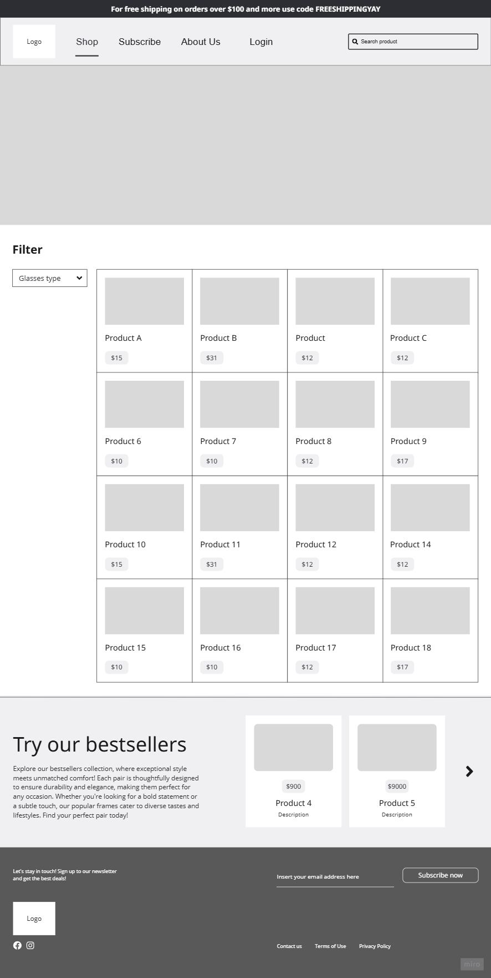
Glasses Selection

Slide 6
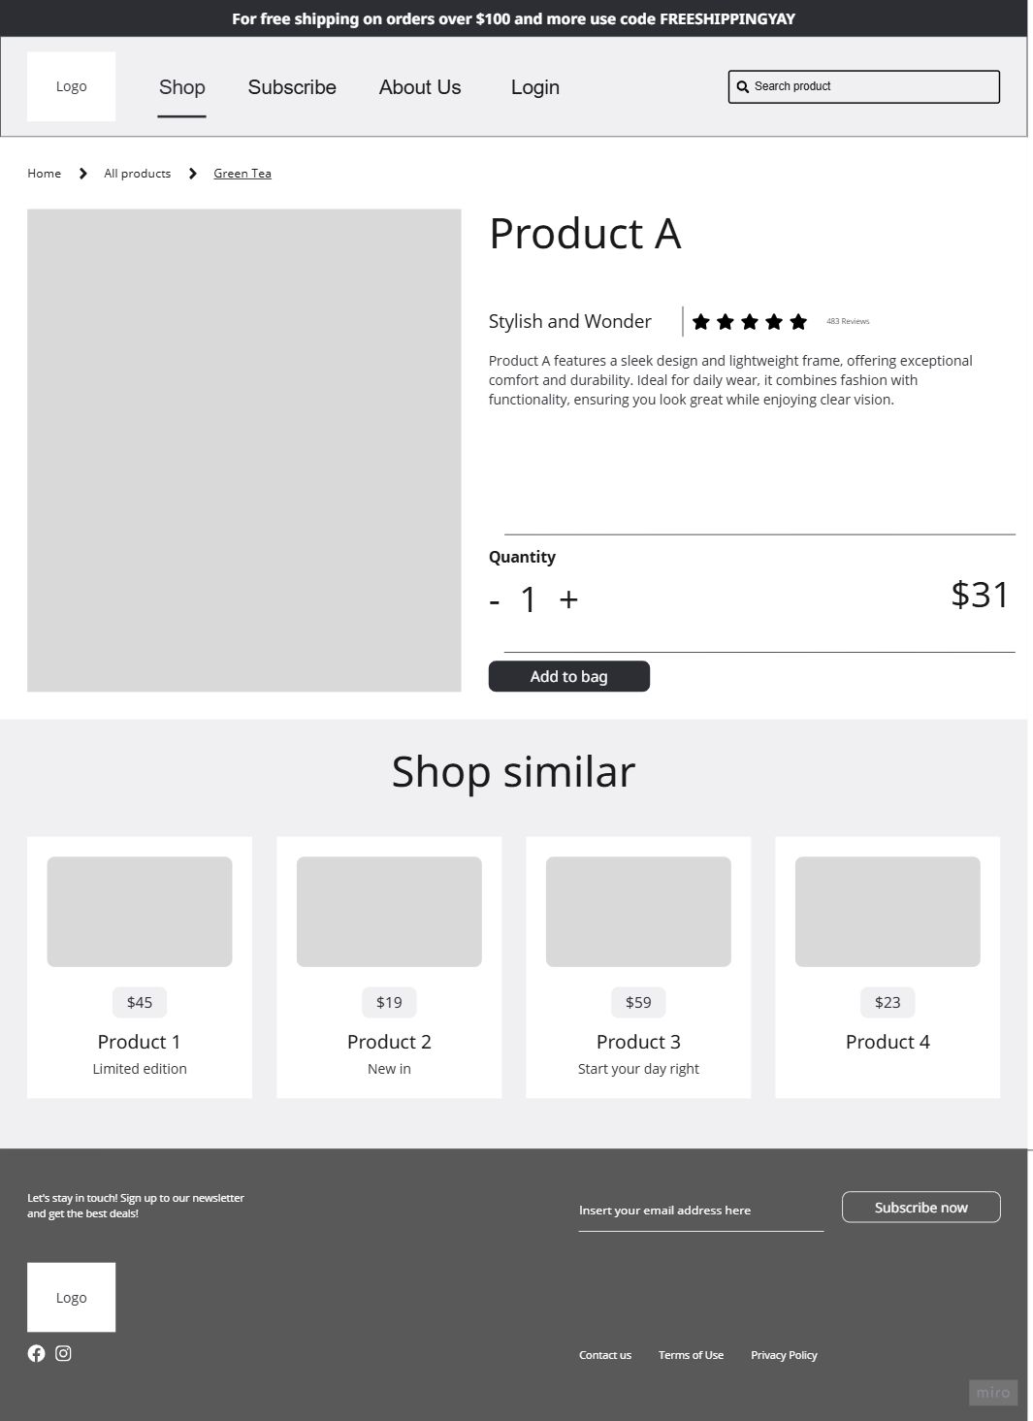
Product Details

Slide 7
Product Details

Slide 8
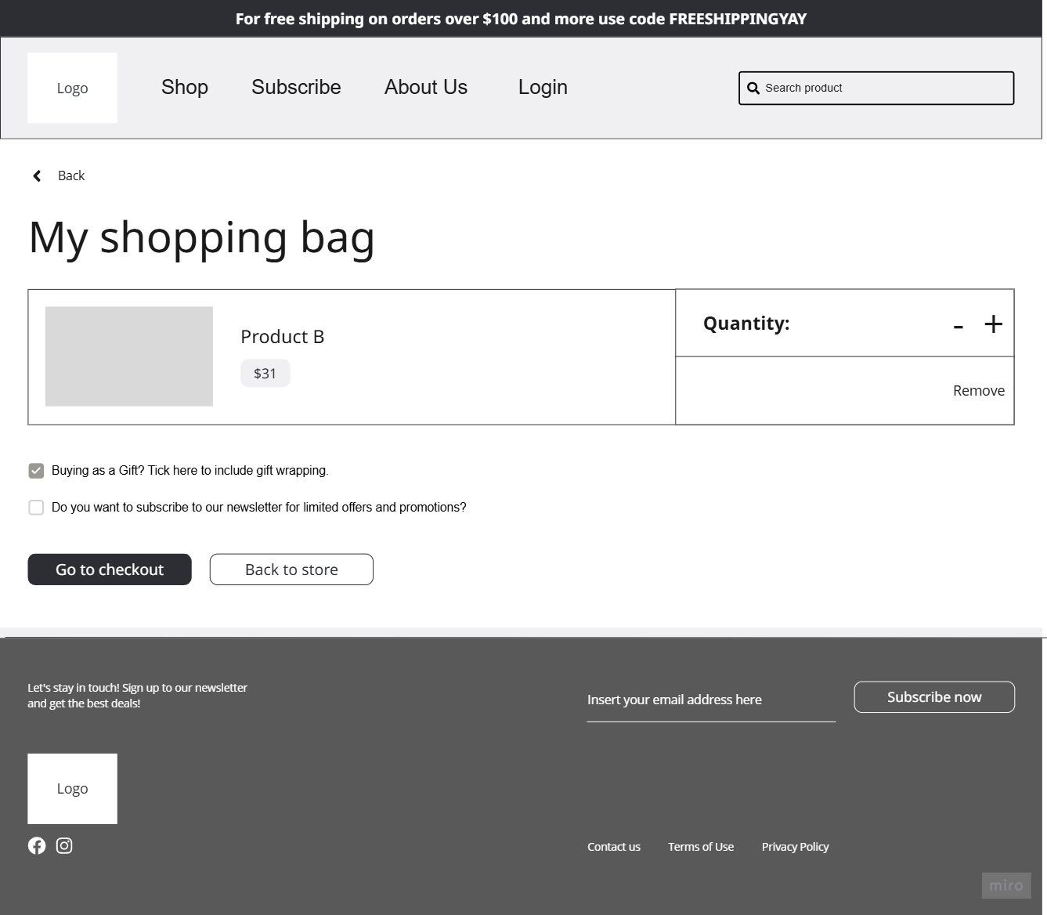
Shopping Basket

Slide 9
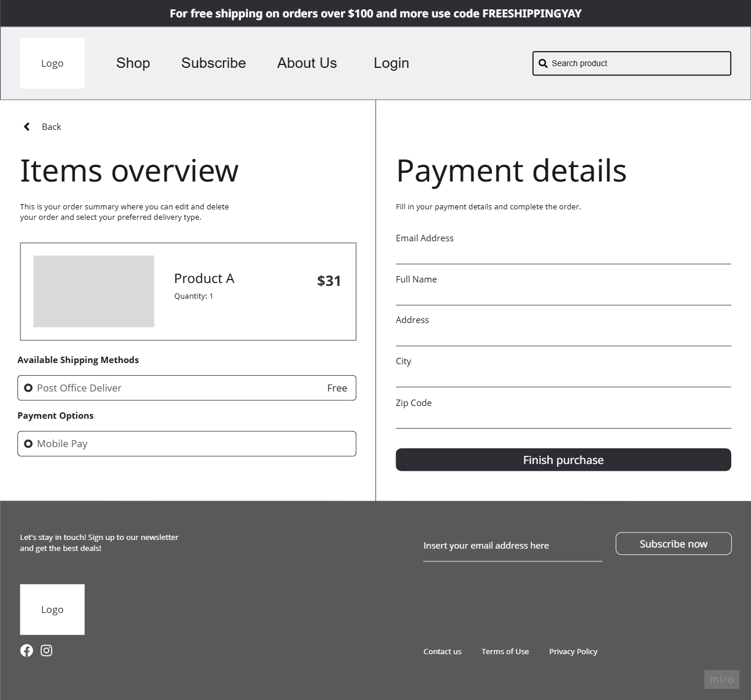
Purchase

Slide 10

Sign Up

Slide 11
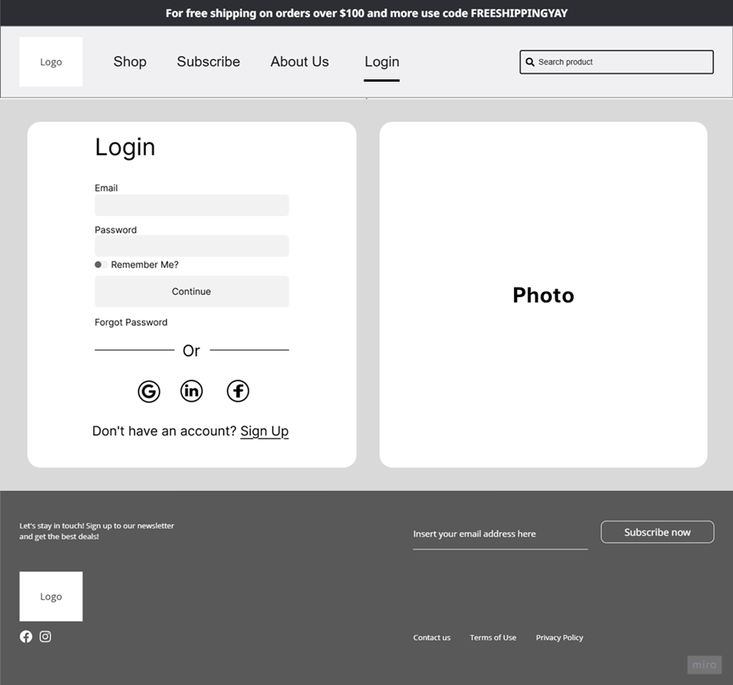
Login

Slide 12
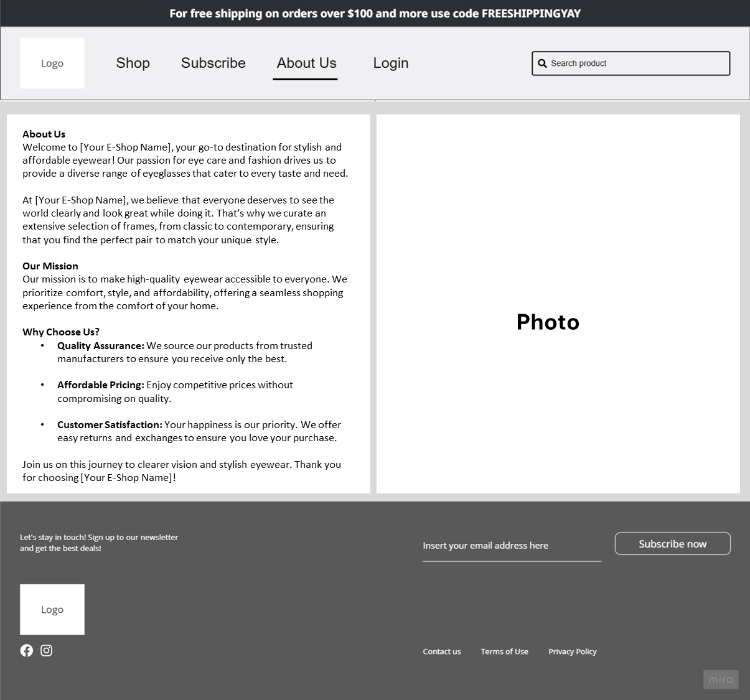
About Us

